Slide 1
Lecture 3:
Basic logic operation and Boolean algebra
Basic logic operation
Boolean algebra
Logical function transformation

Slide 2
Basic logic operation
In digital circuits, the most basic elements of circuits are logic gates that can perform logic operations.
The three basic operations are AND, OR and NOT.
We can use these basic operations to carry out very complex operations.

Slide 3
Basic logic operation
AND logic operation
The result is true none but the all of conditions are true.
For the case of two conditions
If using A and B to express two conditions, L to express the result.
Logic expression:
truth table
truth table
A
B
L
A
B
L
L = A ⋅ B = AB
false
false
false
true = 1
false = 0
0
0
0
false
true
false
0
1
0
true
false
false
0
0
0
true
true
true
1
1
1

Slide 4
Basic logic operation
AND logic operation
Logic expression:
truth table
truth table
A
B
L
A
B
L
false
false
false
true = 1
false = 0
0
0
0
L = A ⋅ B = AB
false
true
false
0
1
0
true
false
false
1
0
0
true
true
true
1
1
1
true = high
high = 1
Logic symbol: (AND gate)
false = low
low = 0
truth table (voltage level)
A
A
B
L
L
low
low
low
B
output
low
high
low
inputs
high
low
low
(AND standard distinctive shape symbol)
high
high
high

Slide 5
Basic logic operation
AND logic operation
For more then two inputs
Logic symbol:
Logic expression:
A
L = ABC
B
...
C
L
...

Slide 6
Basic logic operation
OR logic operation
The result is true as long as anyone of all conditions is true.
For the case of two conditions
Logic expression:
Logic symbol: (OR gate)
truth table
L = A + B
A
B
L
0
0
0
A
L
0
1
1
B
1
0
1
1
1
1
The plus sign is indicated logic OR opertion
(true = 1, false = 0)

Slide 7
Basic logic operation
OR logic operation
For more then two inputs
Logic symbol:
Logic expression:
A
L = A+B+ C+
B
...
L
C
...

Slide 8
Basic logic operation
NOT logic operation
The result and the condition are opposite.
Logic expression:
Logic symbol: (NOT gate)
truth table
L = A
A
L
0
1
A
L
1
0
(true = 1, false = 0)

Slide 9
The topic we’ll discuss
Basic logic operation
Boolean algebra
Logical function transformation

Slide 10
Boolean algebra
In 1854, the logical algebra known today as Boolean algebra was founded and formulated in publication written by George Boole.
In 1938, Claude Shannon was the first to apply Boole’s work to the analysis and design of logic circuits.

Slide 11
Boolean algebra
Boolean algebra is the mathematics of digital systems.
A basic knowledge of Boolean algebra is indispensable to the study and analysis of logic circuits.
It is a convenient and systematic way of expressing and analyzing the operation of logic circuits.
The basic knowledge of Boolean algebra includes 3 laws, 12 basic rules and 2 theorems (DeMorgan’s theorems)

Slide 12
Lows of Boolean algebra
Commutative lows
A + B = B + A
A · B = B · A
Associative lows
A + ( B + C ) = (A + B) + C
A · ( B · C ) = (A · B) · C
Distributive lows
A ( B + C ) = AB + AC
Here, each of the lows is illustrated with two or three variables, but the number of variables is not limited to this.

Slide 13












Rules of Boolean algebra
12 basic rules
A, B, or C can represent a single variable or a combination of variables.

Slide 14
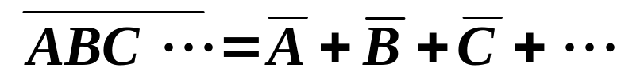
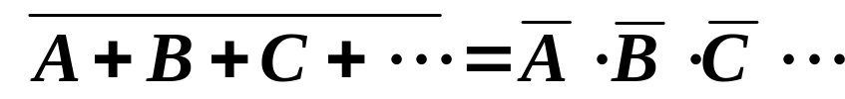
Theorems of Boolean algebra
(DeMorgan’s theorems)
The complement of a product of variables is equal to the sum of the complements of the variables.
The complement of a sum of variables is equal to the product of the complements of the variables.
Each variable can also represent a combination of other variables.

Slide 15
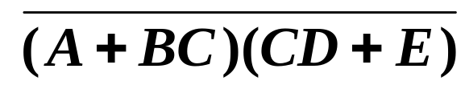
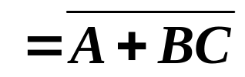
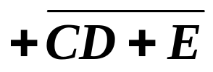

Theorems of Boolean algebra
(DeMorgan’s theorems)
For example
(A+BC) = X, (CD+E) = Y
Correspondence

Slide 16
The topic we’ll discuss
Basic logic operation
Boolean algebra
Logical function transformation

Slide 17
Logical function transformation
Expressing of logical functions
Standard forms of Boolean expressions
The SOP form
The standard SOP form (sum of minterms)
The POS form and standard POS form (product of maxterms)
Conversion of Boolean expression

Slide 18

Logical function transformation
Expressing of logical functions
1. Logical function expression
3. Truth table
inputs A B C | output L
0 0 0
0 0 1
0 1 0
0 1 1
1 0 0
1 0 1
1 1 0
1 1 1
2. Logic circuit
0
0
A
1
C
1
L
B
0
Note:
In truth table, all possible combinations of values for the input variables should be listed.
1
1
1

Slide 19
Logical function transformation
Standard forms of Boolean expressions
All expressions can be converted into the sum-of-products form or the product-of-sums form. It makes the evaluation, simplification, and implementation of Boolean expressions much more systematic and easier.
The sum-of-products form abbreviated SOP
The product-of-sums form abbreviated POS

Slide 20


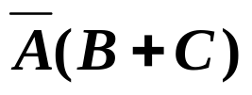


Standard forms of Boolean expressions
The SOP form
Two or more product terms are summed by Boolean addition.
Which belong to SOP?
√
√
√
A single overbar cannot extend over than one variable.
The product term can be only one variable.

Slide 21




Standard forms of Boolean expressions
The standard SOP form (sum of minterms)
A standard SOP expression is one in which all the variables in the domain appear in each product term in the expression.
Which are standard SOP?
√
√
! Each variable must appear once in each product term with the original variable or the complementary variable.

Slide 22
Standard forms of Boolean expressions
The POS form and standard POS form (product of maxterms)
Self-study

Slide 23

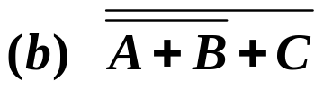
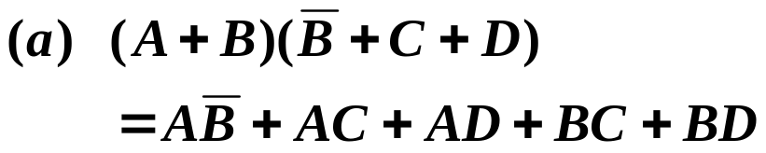



Conversion of Boolean expression
Convert each of the following expression to SOP form:
Solution
Continuously convert them to standard SOP form:

Slide 24


Conversion of Boolean expression
Continuously convert them to standard SOP form:
Multiply anything by 1 without changing its value
Multiply anything by 1 without changing its value
Solution
(Distributive low )

